Slide 1
BOMMINENI THARUN KUMAR
Final Project
3/21/2024 Annual Review

Slide 2
PROJECT TITLE Keylogger and Security
3/21/2024 Annual Review

Slide 3


AGENDA
1. Understanding Keylogger Threats
2. Importance of Security Measures
3. Detection and Prevention Techniques
4. Role of End Users in Security
5. Best Practices for Security Implementation
3/21/2024 Annual Review

Slide 4

PROBLEM STATEMENT
Keyloggers secretly record keystrokes, capturing sensitive information like passwords and personal data. They can be introduced through malware, phishing, and physical access, often bypassing traditional security measures. Effective strategies are needed to prevent, detect, and respond to keylogger threats to protect user data and privacy.
3/21/2024 Annual Review

Slide 5

PROJECT OVERVIEW
Developing robust keylogger detection and security protocols is crucial for protecting sensitive data and maintaining system integrity. These measures enhance user privacy and bolster overall cybersecurity posture. However, implementing such strategies requires ongoing maintenance and resource allocation. Balancing the benefits of enhanced security with the challenges of resource-intensive implementation is essential. By prioritizing keylogger detection and security, organizations can mitigate risks and safeguard against unauthorized access to sensitive information. This proactive approach strengthens resilience against evolving cyber threats, ensuring the integrity and confidentiality of data across various computing environments.
3/21/2024 Annual Review

Slide 6

WHO ARE THE END USERS?
Hackers.
IT companies.
Cybercriminals
Law Enforcement and Intelligence Agencies
Individuals
IT Administrators and Security Professionals
3/21/2024 Annual Review

Slide 7

SOLUTION AND ITS VALUE PROPOSITION
- Effective Detection:Our software swiftly identifies and blocks keyloggers, protecting sensitive data and user privacy.
- Proactive Defense:With advanced algorithms, it preemptively detects threats, minimizing the risk of data breaches.
- User-Friendly Interface: Easy-to-use interface facilitates seamless integration and operation.
- Cost-Effective Security:Provides robust protection at an affordable price, reducing financial risks associated with breaches.
- Comprehensive Protection:Ensures data integrity and confidentiality, safeguarding against evolving cyber threats.
3/21/2024 Annual Review

Slide 8

THE WOW IN YOUR SOLUTION
1.Real-Time Monitoring and Alerts
2.Advanced Data Encryption
3.AI-Powered Anomaly Detection
4.Ethical and Transparent Use Cases
5.Cross-Platform Compatibility and Stealth Mode
3/21/2024 Annual Review

Slide 9
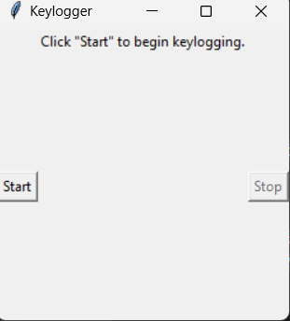
MODELLING
1.System Architecture
2.Keystroke Capture
3.Data Storage and Management
4.User Interface and Accessibility
5.Security and Privacy
6.Performance and Efficiency
7.Real-Time Monitoring and Notifications
8.Testing and Validation
Before & after starting of keylogger
3/21/2024 Annual Review

Slide 10
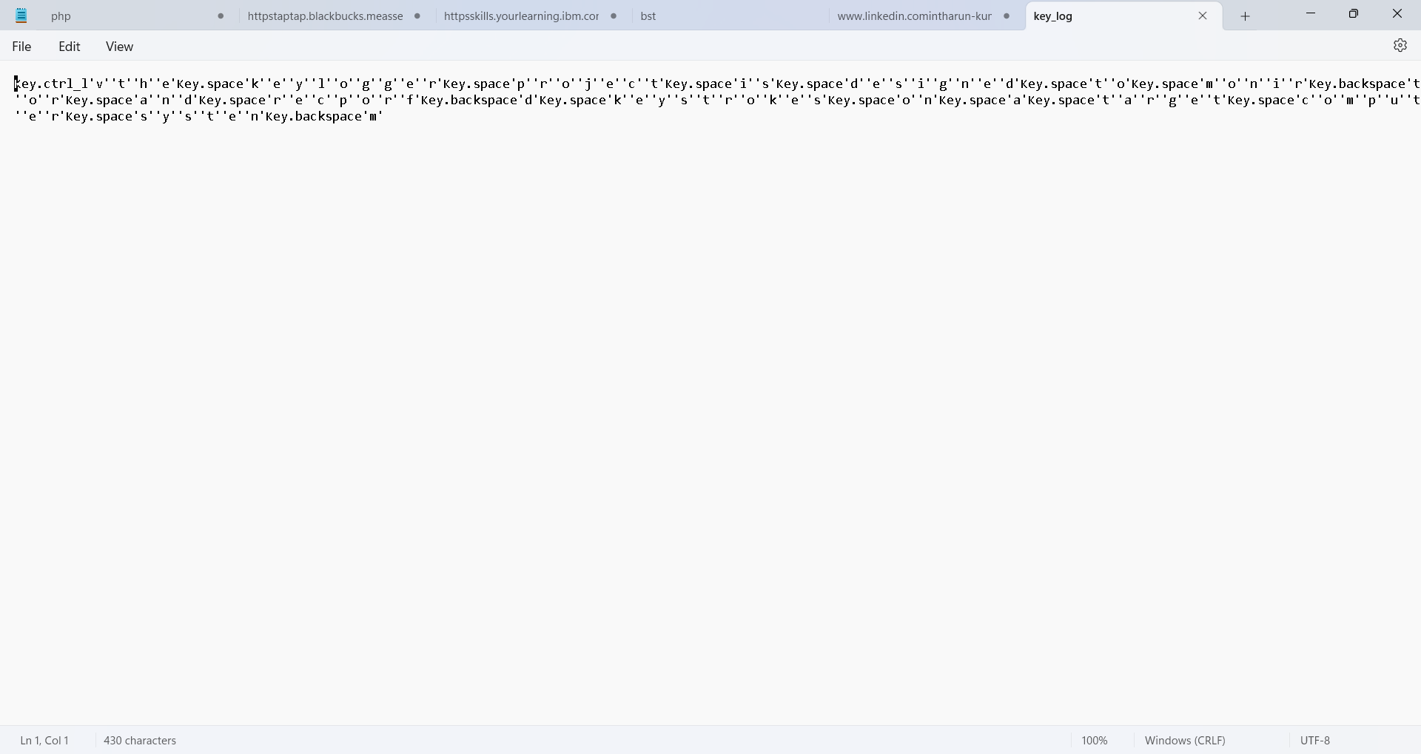
RESULTS
3/21/2024 Annual Review

Slide 11
RESULT
The final results of a well-developed keylogger project include accurate and secure keystroke capture across multiple platforms, with minimal impact on system performance. It features an intuitive dashboard for real-time monitoring, search, and alerts, while ensuring data is encrypted and access-controlled. The project emphasizes ethical use with user consent mechanisms, complies with relevant privacy laws, and provides comprehensive documentation and customer support. Robust testing ensures functionality, security, and usability, promoting responsible and legal keylogging practices.

